Slide 1
Applied Data Science Project 5 Jason LI Dejian WANG Yuxin ZHU Ke HAN

Slide 2
Summary
We combined core value of 8 published articles related to Earnings Release and improve it with machine learning strategy. Finally, we got two models:
long-before earning release
short-after earning release
The model is based on one assumption:
Before earning release, stocks with strong momentum will attract people to buy since people believe that the Earnings Report exceed expectations, the price will increase in a short period. And after earning release, some people will cash in and the price will drop in a short period. In summary, long before Earning release, short after it.
Our model could tell you, if you long the stock before earning announcement, whether you could a positive return. If you short the stock after earning announcement, whether you could get a positive return.
Initially, we use 1000 stocks data in 10 years, got 963 K observation and use forward stepwise to select the most important two factors which are momentum. This step is to find a pattern of stocks which are sensitive to Earning announcement.
Based on the pattern we found in step 1, we selected fewer observations and use machine learning model to do classification and got 0.88 accurate rate with Random Forest.
Notes:
准确率不同：
吸引人 我们选不出
兑现 都存在
The predictors used：
PS: price to sale
PB: price to book
EV2EBITDA: Enterprise value by EBITDA
PE: price to earnings
EBITG: EBIT growth
M2B: market capitalization to book value
DV: average dividend yield
PF: Price to free cash flow
Surprise: earning surprise

Slide 3
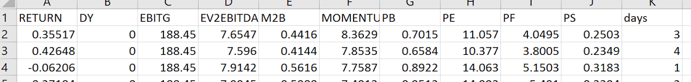
Introduction
Select potential stocks
NLP to improve model
Narrow down to certain horizon
Classification model to decide strategy
Summary
Scope
Using the financial data set
Focused on Earning release date related days
Using the US market most liquidity stock
Across more than 10 years investment horizon
Data Description
Using more than 1000 stocks
Using more than 39k+ entries
Including financial fundamental information
This is the reason there are so many NA, and too dirty the data set
Data Science related
Predictive modeling
Classification models
NLP to generated features
Data visualization

Slide 4
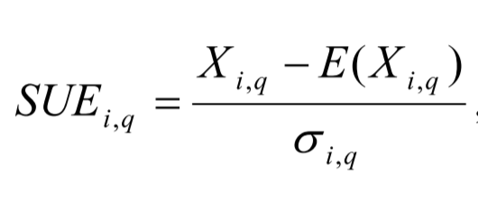
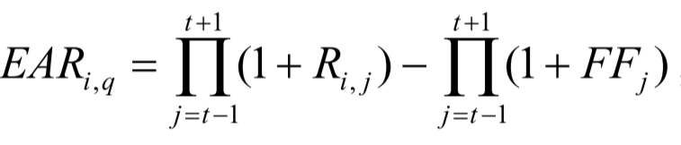
Step 0: Related Papers and Projects
Adaptive Asset Allocation
Adaptive asset allocation is a process of constantly rotating into asset with
Adaptive momentum
Volatility
Correlation factors
Defined as the an asset with the greatest relative performance over the past 1 month to 1 year is more likely to exhibit stronger performance over the next few days or weeks
Some reasons for Momentum:
perceptions of risk
human cognitive biases
the operation of markets
Momentum
Earning announcement related
There are two main indicators:
SUE (Standardized unexpected earnings)
EAR (Earning announcement return)
Here, FF stands for the benchmark size &book t- market FF portfolio
And the related trading strategy are:
Long the stocks with positive announcement
Short the portfolio with negative announcement

Slide 5

Step 1: Data collection and Description
Load data
Data source: Using Bloomberg, Scraping techniques
Size: including financial data 39034 entries (based on the volatility, choose the most volatility ones), news related txt files
Size: 9 files with a total size of 150 MB
Horizon
Based on the Earning released projects on the previous page, we focused on the earning released date -6 to 6 horizon
In our data set, the earning release is covering 2006 to 2016 earning release (can refer to earning calendar)
Data processing
Calculated and processed the dividend yield ratio, enterprise value to EBITDA ratio, market to book ratio, Momentum, price to sales ratio, days( based on the data to earning release) etc.
For example here,
Momentum is based on the price
(CLOSE( J ) / CLOSE( J – N ) * 100 )
Fama French Book to market ratio
*Full code can be found in the R markdown file in github
*http://www.nasdaq.com/earnings/earnings-calendar.aspx

Slide 6
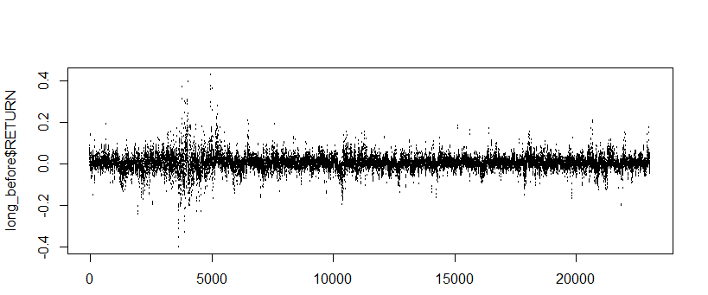
Step 2: Select the stocks based on their Momentum
Select Stocks
Major strategies
After comparing some subset of the stocks, we decided to pick up a most sensitive, also known as influential
We run a stepAIC to figure out the importance of the variables
In the regression, we see that Momentum and Price to sales ratio is the most important one
Choose stocks based on those two criteria, limited our sample size, so we focused on the Momentum
We choose most momentum stocks!
Long VS Short
Before Earning Release VS After
Our assumptions: Before earning release, stocks with strong momentum will attract people to buy since people believe that the Earnings Report exceed expectations, the price will increase in a short period. And after earning release, some people will cash in and the price will drop in a short period.
Summarized to 2 models:
long-before earning release
short-after earning release
 | Before Earning Release | After Earning Release
All stocks | 1.58% | 1.86%
Momentum | 3.09% | 3.05%
*Full code can be found in the R markdown file (Main) in github

Slide 7
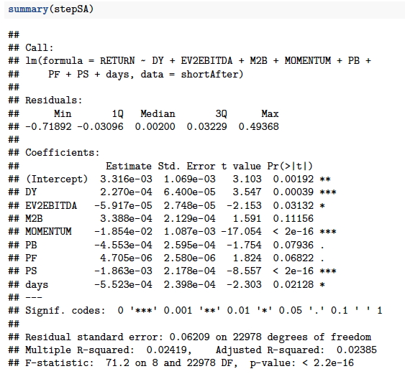
Step 2(continue): Exploratory analysis
AIC step result
Statistical Description of the data
Name | Mean | Median
Dividend yield | 3.07 | 2.069
EBITG | 40.35 | 0.24
EV/EBITDA | 11.77 | 9.19
M/B | 5.64 | 2.80
Momentum | -0.032 | -0.104
P/E ratio | 22.59 | 13.96
P/S ratio | 2.11 | 1.64
Return | 0.0033 | 0.0020
Days | 3.5 | 4.0
Surprise | 10.73 | 3.70
P/F ratio | 28.19 | 14.35

Slide 8
Step 3: Classification model
Final model
Features-> models
Models comparison
Result evaluation
After feature selection and running Gradient Boosting Machine, BP Neural network, Random Forest, Logistic regression, Supported Vector Machine,
Model comparison:
SVM:
tuning on bandwidth and using kernel RBF
Random Forest: tuning on mtry
Logistic regression:
tuning on bandwidth
GBM: Gradient Boosting Machine
NNET: feed-forward neural networks with a single hidden layer, and for multinomial log-linear models
We summarized the prediction accuracy on test data set and runtime analysis
The best result we can get is 82%!
*Full code can be found in the R file attached

Slide 9
Step 3(continue): Models Summary
Short After Model Summary
Method | Precision | Recall | F1 | Accuracy | Time
GBM | 0.71 | 0.88 | 0.78 | 0.70 | 0.14666295 secs
SVM | 0.76 | 0.79 | 0.78 | 0.72 | 33.51036286 secs
NNET | 0.68 | 0.84 | 0.75 | 0.66 | 84.84540105 secs
RF | 0.84 | 0.88 | 0.86 | 0.88 | 4.17855310 secs
Logistic | 0.62 | 1.00 | 0.76 | 0.62 | 0.01478505 secs
Long Before Model Summary
Method | Precision | Recall | F1 | Accuracy | Time
GBM | 0.55 | 0.59 | 0.57 | 0.61 | 0.3874459 secs
SVM | 0.61 | 0.72 | 0.66 | 0.68 | 107.2432630 secs
NNET | 0.56 | 0.65 | 0.60 | 0.63 | 72.2320290 secs
RF | 0.67 | 0.70 | 0.69 | 0.72 | 4.8966820 secs
Logistic | 0.47 | 0.50 | 0.48 | 0.54 | 0.0203681 secs
Notes:
The exact result sometimes change,

Slide 10
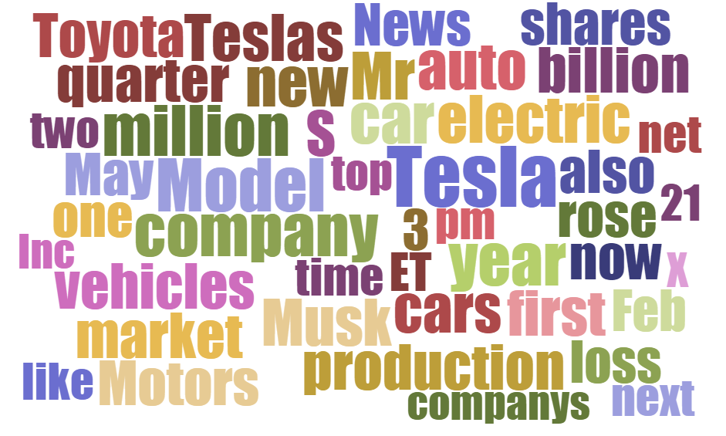
Step 4: Trading on News! Including news features from NLP
Scraping news /earning
Models evaluation
Extracting features
Building up model based on news, we actually face a worse result compared to financial indicators
Compared the mixed portfolio and specific stock, suffered from less than 50% accuracy
How to utilized this, we can more flexibility change our portfolio and gain better result(maybe more tuning on the horizon in future analysis)
News and analytic articles
We would like to analyze if these articles from mainstream media could influence stock market and investor’s trading strategies
EPS vs Forecast
How much the actual EPS bits consensus expectation is also a key factor to be considered for investment strategy
Those features would expand our info

Slide 11

Step 4(Continue): For mixed portfolio
Mixed portfolio, commercial words would stand out
But we see that the model is still troublesome
Notes:
http://www.wordclouds.com

Slide 12
Comparison of models
Method | Precision | Recall | F1 | Accuracy | Time
Short after | 0.71 | 0.88 | 0.78 | 0.83 | 4.2500598secs
NLP | 0.47 | 0.68 | 0.56 | 0.44 | 0.3933802 secs
Discussion
It clear to see that the model build by natural language processing is quite lack of predicting ability
Some of the reason
Data collection: when focused on specific stocks, the news and articles are quite distinct, too limited information with too many NAs. We also understand why so many people trading only on index based on this method
This also is an idea for using Periodic or recurring events like federal reserve disclosure to trade interest rate
NLP analysis: The sentiment result from toolkit is too general to apply for financial news and our word vector list is quite limited
*http://www.investopedia.com/articles/active-trading/111313/how-trade-news.asp
Notes:
http://www.investopedia.com/articles/active-trading/111313/how-trade-news.asp

Slide 13
Summary and Improvement
Summary
Stock market is known as a chaotic system. We get more information on news by limiting our scope to earning release day, and are able to build the prediction model of more than 85% accuracy, and better with NLP
Models and features: GBM, SVM, NNET, RF, Logistic, Random forest gives us the best among all of them
Further, it is observed that data visualization from different companies shows that data set from a certain company is much more distinguishable than mixing data (portfolio and index)
Compared with our goal, we just made it. Check whether the strategy still works with recent 10 years data/ Improve the model with statistical technique / Predict whether to long or short before & after Earnings Release
Discussion
We use their core value: long before Earnings Release, Short after Earnings Release and use machine learning model to improve it
Future work
NLP analysis: The sentiment result from toolkit is too general to apply for financial news and our word vector list is quite limited
Model Improvement: high dimension can be handled better

Slide 14
Thank You ! Contact Information: Jason LI
Dejian WANG
Yuxin ZHU
Ke HAN

Slide 15
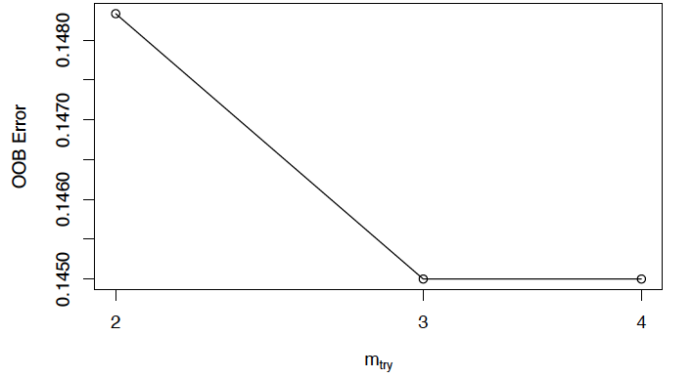
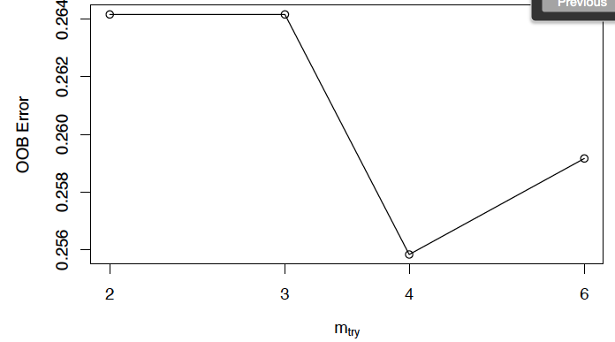
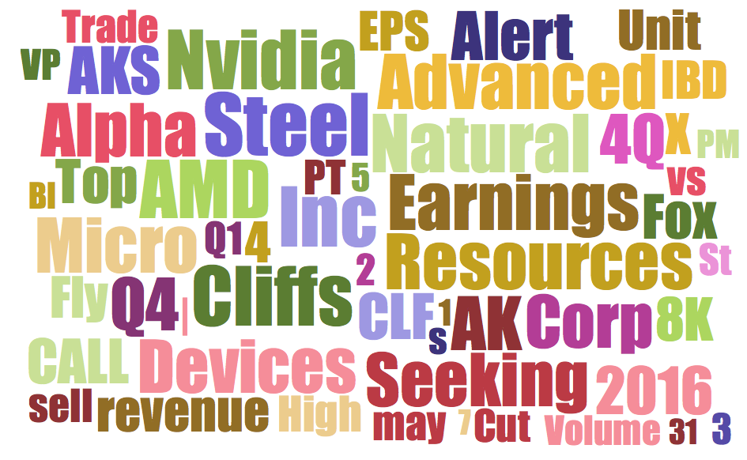
Attachment: graphics related to training process
Short After (RF tuning) Long Before (RF tuning)
Word Cloud for the mixed data set

